Slide 1
Natural Gardening
Working in harmony with the world around you

Slide 2
Criteria
Appropriate to land
Appropriate to climate
Sustainable

Slide 3
Results
Encourages diversity
Attracts pollinators
Attracts birds

Slide 4
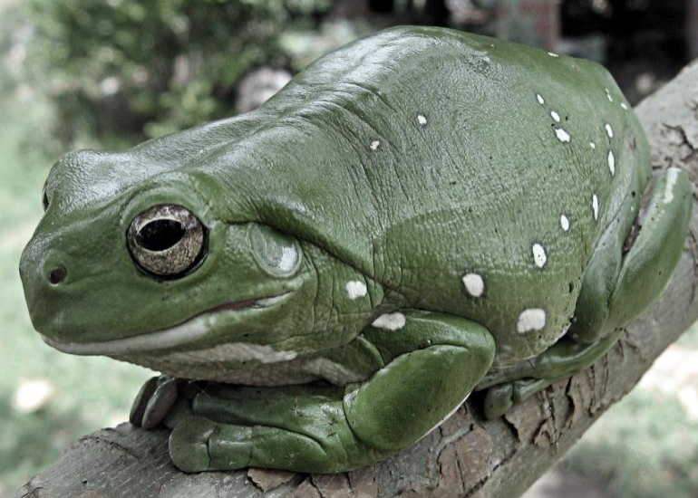
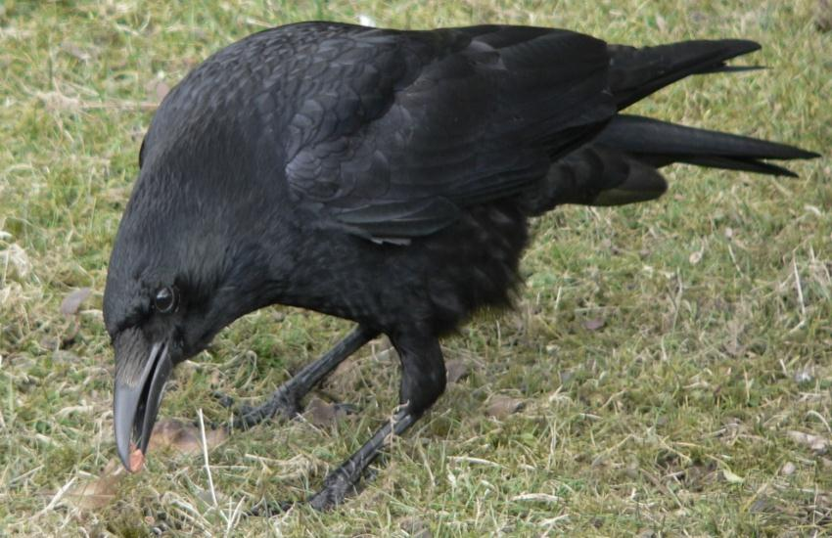
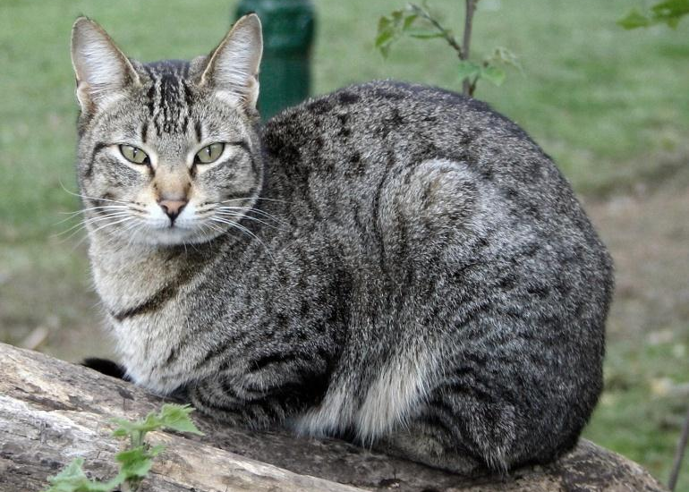
Garden Residents

